Slide 1

PROJECT CARD
EASY
ADVANCED

Slide 2

PROJECT CARD
GOAL:
Build, train, test and deploy a machine learning regression model to predict used car prices based on their features
TOOL:
AWS SageMaker Studio
PRACTICAL REAL-WORLD APPLICATION:
This project can be effectively used by car dealerships to predict used car prices and understand key factors that contribute to used car prices.
DATA:
INPUTS:
Make, Model, Type, Origin, Drivetrain, Invoice, EngineSize, Cylinders, Horsepower, MPG_City, MPG_Highway, Weight, Wheelbase, and Length
OUTPUT:
MSRP (Price)
Image Source: https://www.flickr.com/photos/pasa/6757993805
Dataset Source: https://www.kaggle.com/ljanjughazyan/cars1
Image Source: https://www.flickr.com/photos/pasa/6757993805
Dataset Source: https://www.kaggle.com/ljanjughazyan/cars1

Slide 3
INPUTS AND OUTPUTS
INPUTS
OUTPUT
MAKE
MODEL
TYPE
ORIGIN
DRIVETRAIN ENGINESIZE CYLINDERS
HORSEPOWER
MPG CITY
MPG HIGHWAY WEIGHT
WHEELBASE LENGTH
VEHICLE PRICE (MSRP)
ML MODEL

Slide 4
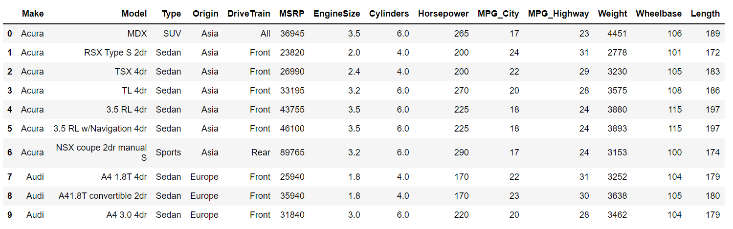
DATA OVERVIEW
MODEL OUTPUT: MSRP MANUFACTURER'S SUGGESTED RETAIL PRICE

Slide 5
SUCCESS STORIES
EASY
ADVANCED

Slide 6
SUCCESS STORIES
Price prediction of products and services is critical for any company to maximize revenues and reduce costs.
Fareboom.com is an innovative tool that leverages machine learning to predict flight prices. The tool has been developed by AltexSoft.
The fare forecast feature has been developed to help users make better purchasing decisions.
The tool can guide customers to select the best time to purchase a flight.
The tool is built on a self learning machine learning algorithm that can predict future price movements while taking into account historical data, airlines deals, demand, and seasonal effects.
Great case studies: https://www.altexsoft.com/case-studies/
Fare price prediction tool: https://www.altexsoft.com/case-studies/travel/altexsoft-creates-unique-data-science-and-analytics-based-fare-predictor-tool-to-forecast-price-movements/
Source: https://www.altexsoft.com/blog/datascience/data-science-and-ai-in-the-travel-industry-9-real-life-use-cases/

Slide 7

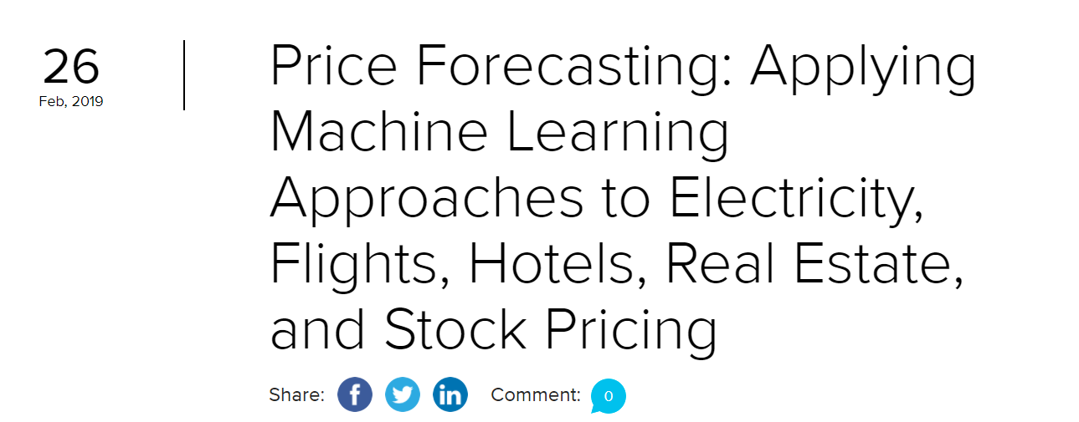

READING TIME & QUIZ: AI/ML APPLICATIONS IN PRICE FORECASTING
Please read the article below and answer the following quiz.
Link to Article: https://www.altexsoft.com/blog/business/price-forecasting-machine-learning-based-approaches-applied-to-electricity-flights-hotels-real-estate-and-stock-pricing/
10 MINS
5 MINS

Slide 8
MULTIPLE LINEAR REGRESSION 101
EASY
ADVANCED

Slide 9

RECALL SIMPLE LINEAR REGRESSION?
Goal is to obtain a relationship (model) between two variables only such as age and insurance cost for example.
MODEL! (GOAL)
$$y=b+m∗x$$
CAR PRICE ($)
DEPENDANT VARIABLE
CAR PRICE ($)
INDEPENDENT VARIABLE
ENGINE SIZE
ENGINE SIZE

Slide 10

MULTIPLE LINEAR REGRESSION: INTUITION
Multiple Linear Regression: examines relationship between more than two variables.
Recall that Simple Linear regression is a statistical model that examines linear relationship between two variables only.
Each independent variable has its own corresponding coefficient.
$$y=b_{0}+b_{1}∗x_{1}+b_{2}∗x_{2}+..+b_{n}x_{n}$$
DEPENDANT VARIABLES
CAR PRICE ($)
INDEPENDENT VARIABLES
(ENGINE SIZE, MPG, MAKE, MODEL, YEAR..ETC)

Slide 11
REGRESSION METRICS AND KPIs
EASY
ADVANCED

Slide 12




REGRESSION METRICS: HOW TO ASSESS MODEL PERFORMANCE?
After model fitting, we would like to assess the performance of the model by comparing model predictions to actual (True) data
$y_{i}$ (actual)
$$Error$$
$$Residuals (Error)={\hat{y}}_{i}−y_{i}$$
CAR PRICE ($)
${\hat{y}}_{i}$(estimated/predicted)
ENGINE SIZE

Slide 13
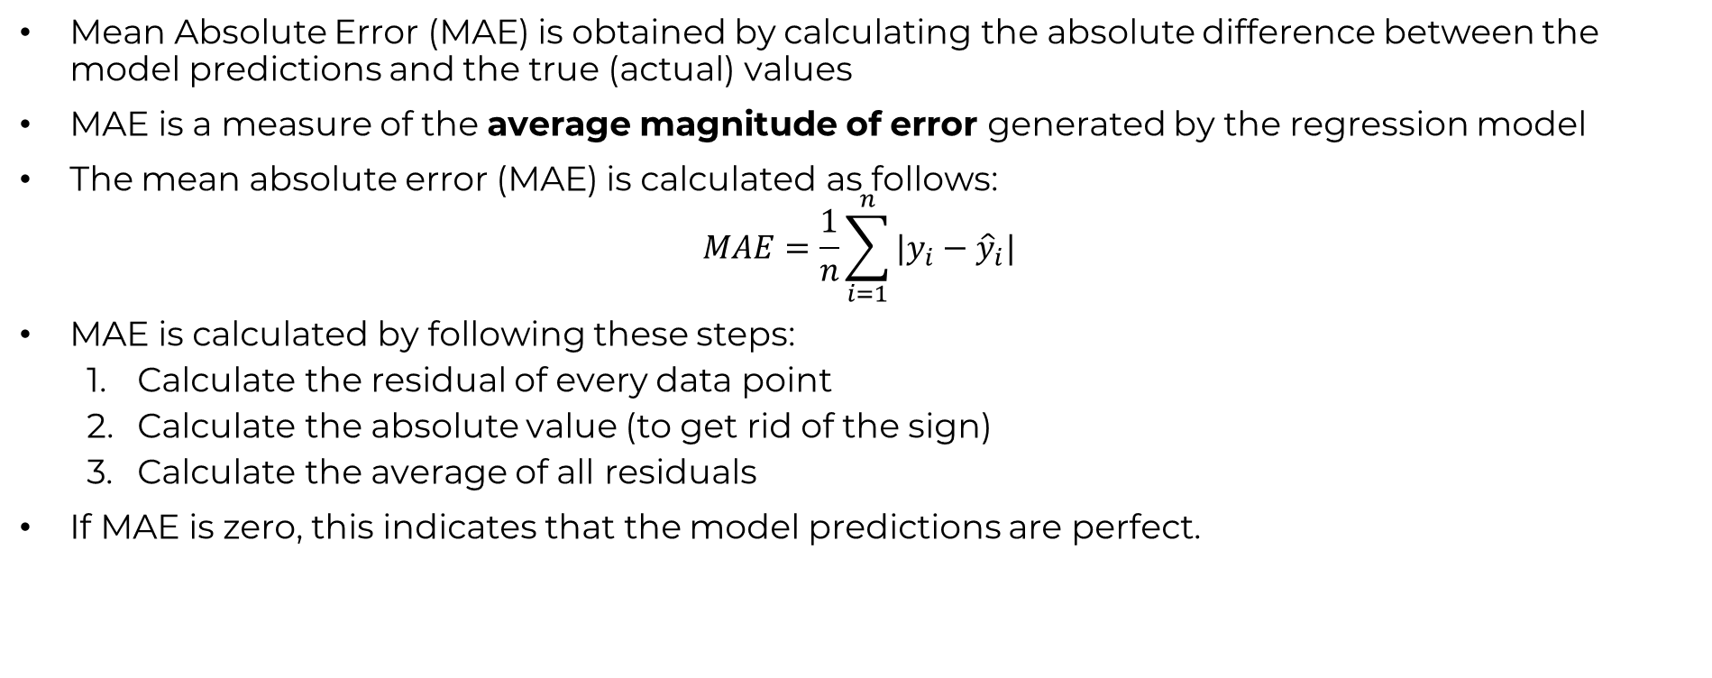
REGRESSION METRICS: MEAN ABSOLUTE ERROR (MAE)
Mean Absolute Error (MAE) is obtained by calculating the absolute difference between the model predictions and the true (actual) values
MAE is a measure of the average magnitude of error generated by the regression model
The mean absolute error (MAE) is calculated as follows:
$$MAE=\frac{1}{n}\sum_{i=1}^{n}{|y_{i}−{\hat{y}}_{i}|}$$
MAE is calculated by following these steps:
Calculate the residual of every data point
Calculate the absolute value (to get rid of the sign)
Calculate the average of all residuals
If MAE is zero, this indicates that the model predictions are perfect.

Slide 14
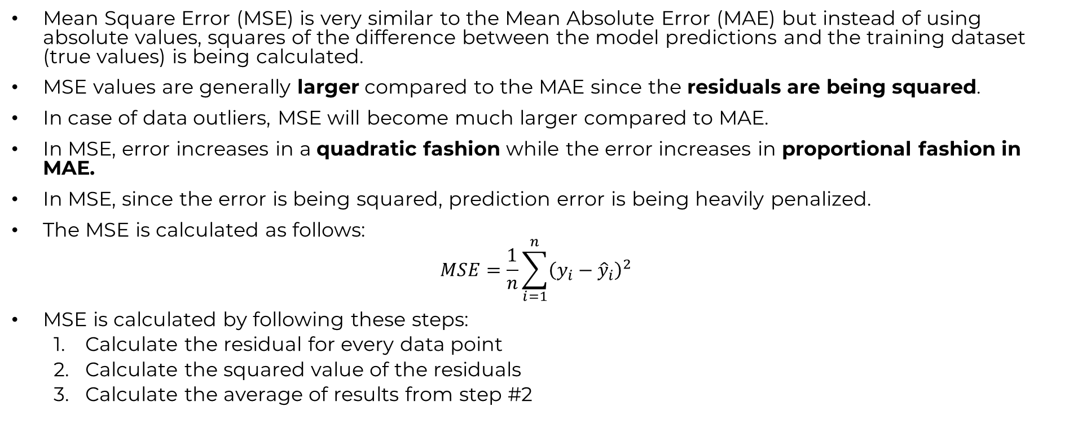
REGRESSION METRICS: MEAN SQUARE ERROR (MSE)
Mean Square Error (MSE) is very similar to the Mean Absolute Error (MAE) but instead of using absolute values, squares of the difference between the model predictions and the training dataset (true values) is being calculated.
MSE values are generally larger compared to the MAE since the residuals are being squared.
In case of data outliers, MSE will become much larger compared to MAE.
In MSE, error increases in a quadratic fashion while the error increases in proportional fashion in MAE.
In MSE, since the error is being squared, prediction error is being heavily penalized.
The MSE is calculated as follows:
$$MSE=\frac{1}{n}\sum_{i=1}^{n}{{\left(y_{i}−{\hat{y}}_{i}\right)}^{2}}$$
MSE is calculated by following these steps:
Calculate the residual for every data point
Calculate the squared value of the residuals
Calculate the average of results from step #2

Slide 15
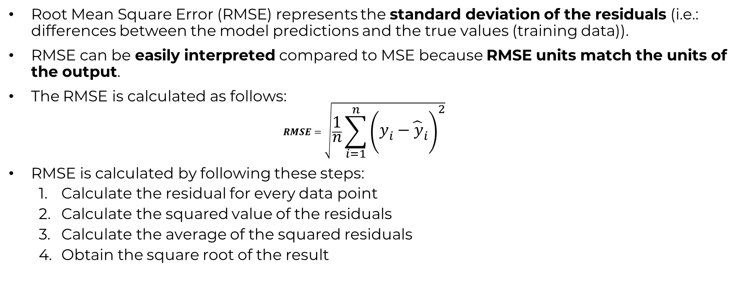
REGRESSION METRICS: ROOT MEAN SQUARE ERROR (RMSE)
Root Mean Square Error (RMSE) represents the standard deviation of the residuals (i.e.: differences between the model predictions and the true values (training data)).
RMSE can be easily interpreted compared to MSE because RMSE units match the units of the output.
The RMSE is calculated as follows:
$$RMSE=\sqrt{\frac{1}{n}\sum_{i=1}^{n}{{\left(y_{i}−{\hat{y}}_{i}\right)}^{2}}}$$
RMSE is calculated by following these steps:
Calculate the residual for every data point
Calculate the squared value of the residuals
Calculate the average of the squared residuals
Obtain the square root of the result

Slide 16
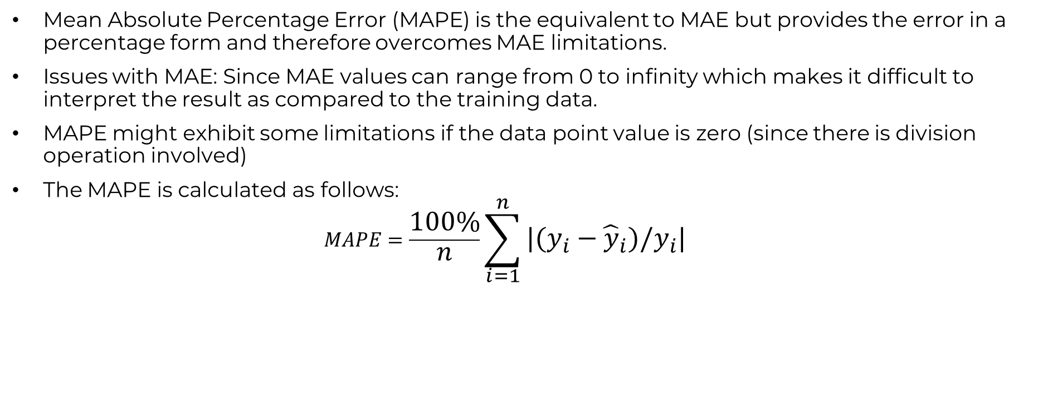
REGRESSION METRICS: MEAN ABSOLUTE PERCENTAGE ERROR (MAPE)
Mean Absolute Percentage Error (MAPE) is the equivalent to MAE but provides the error in a percentage form and therefore overcomes MAE limitations.
Issues with MAE: Since MAE values can range from 0 to infinity which makes it difficult to interpret the result as compared to the training data.
MAPE might exhibit some limitations if the data point value is zero (since there is division operation involved)
The MAPE is calculated as follows:
$$MAPE=\frac{100\%}{n}\sum_{i=1}^{n}{|(y_{i}−{\hat{y}}_{i})/y_{i}|}$$

Slide 17

REGRESSION METRICS: MEAN PERCENTAGE ERROR (MPE)
MPE is similar to MAPE but without the absolute operation
MPE is useful to provide an insight of how many positive errors as compared to negative ones
The MPE is calculated as follows:
$$MPE=\frac{100\%}{n}\sum_{i=1}^{n}{(y_{i}−{\hat{y}}_{i})/y_{i}}$$

Slide 18
REGRESSION METRICS AND KPIs (PART 2)
EASY
ADVANCED

Slide 19


REGRESSION METRICS: R SQUARE ($R^{2}$)-COEFFICIENT OF DETERMINATION
R-square or the coefficient of determination represents the proportion of variance (of y) that has been explained by the independent variables in the model.
If $R^{2}=80$, this means that 80% of the increase in the car price is due to increase in the engine size.
CAR PRICE ($)
ENGINE SIZE

Slide 20
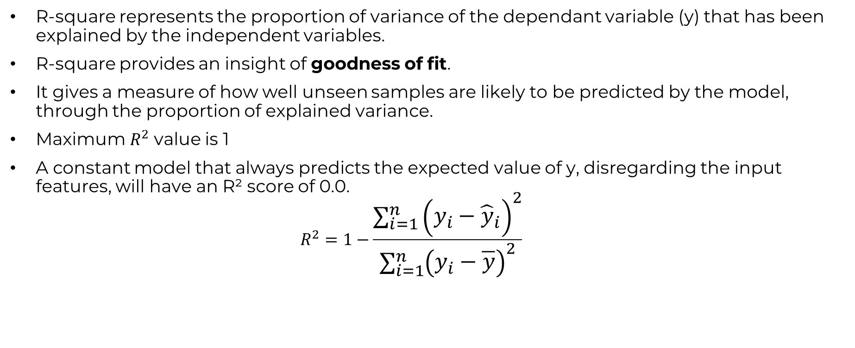

REGRESSION METRICS: R SQUARE ($R^{2}$)-COEFFICIENT OF DETERMINATION
R-square represents the proportion of variance of the dependant variable (y) that has been explained by the independent variables.
R-square provides an insight of goodness of fit.
It gives a measure of how well unseen samples are likely to be predicted by the model, through the proportion of explained variance.
Maximum $R^{2}$ value is 1
A constant model that always predicts the expected value of y, disregarding the input features, will have an R² score of 0.0.
$$R^{2}=1−\frac{\sum_{i=1}^{n}{{\left(y_{i}−{\hat{y}}_{i}\right)}^{2}}}{\sum_{i=1}^{n}{{\left(y_{i}−\overline{y}\right)}^{2}}}$$

Slide 21


REGRESSION METRICS: ADJUSTED R SQUARE ($R^{2}$)
If $R^{2}=80$, this means that 80% of the increase in the car’s price is due to increase in engine size.
Let’s add another ‘useless’ independent variable, let’s say “age of the car driver” to the Z-axis.
Now $R^{2}$ increases and becomes: $R^{2}=85\%$
CAR PRICE ($)
AGE OF CAR DRIVER
ENGINE SIZE

Slide 22
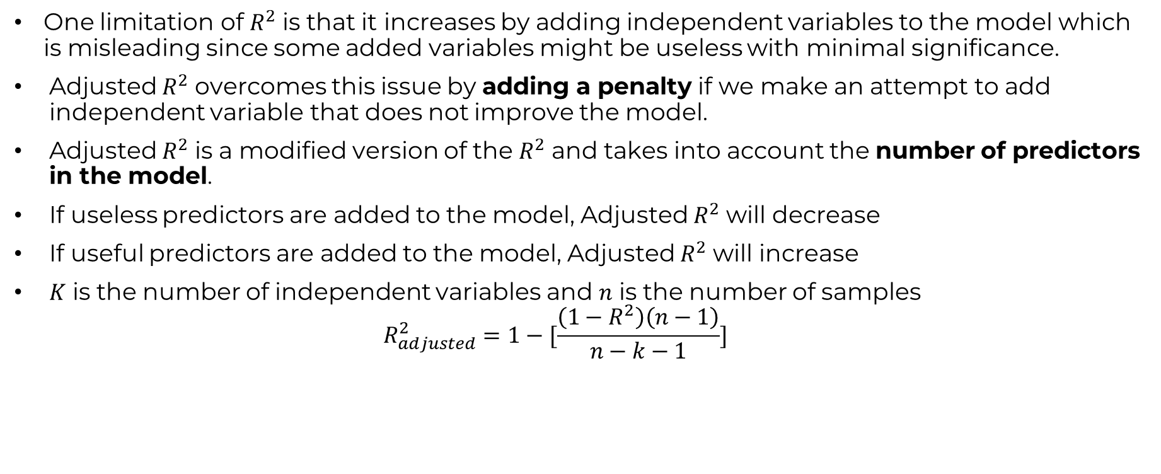

REGRESSION METRICS: ADJUSTED R SQUARE ($R^{2}$)
One limitation of $R^{2}$ is that it increases by adding independent variables to the model which is misleading since some added variables might be useless with minimal significance.
Adjusted $R^{2}$ overcomes this issue by adding a penalty if we make an attempt to add independent variable that does not improve the model.
Adjusted $R^{2}$ is a modified version of the $R^{2}$ and takes into account the number of predictors in the model.
If useless predictors are added to the model, Adjusted $R^{2}$ will decrease
If useful predictors are added to the model, Adjusted $R^{2}$ will increase
$K$ is the number of independent variables and $n$ is the number of samples
$$R_{adjusted}^{2}=1−[\frac{\left(1−R^{2}\right)\left(n−1\right)}{n−k−1}]$$

Slide 23
AMAZON SAGEMAKER DOMAIN SETUP [SKIP IF FAMILIAR]
EASY
ADVANCED

Slide 24
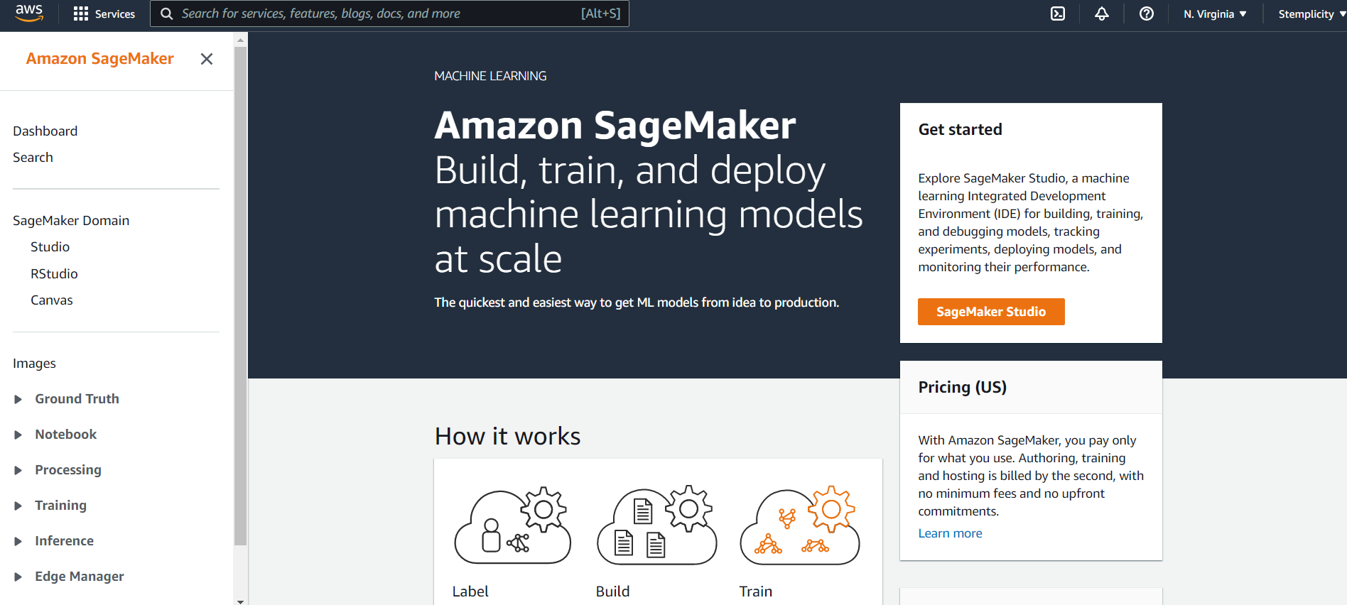
AWS SAGEMAKER DOMAIN SETUP
AMAZON SAGEMAKER HOMEPAGE, CLICK ON STUDIO

Slide 25
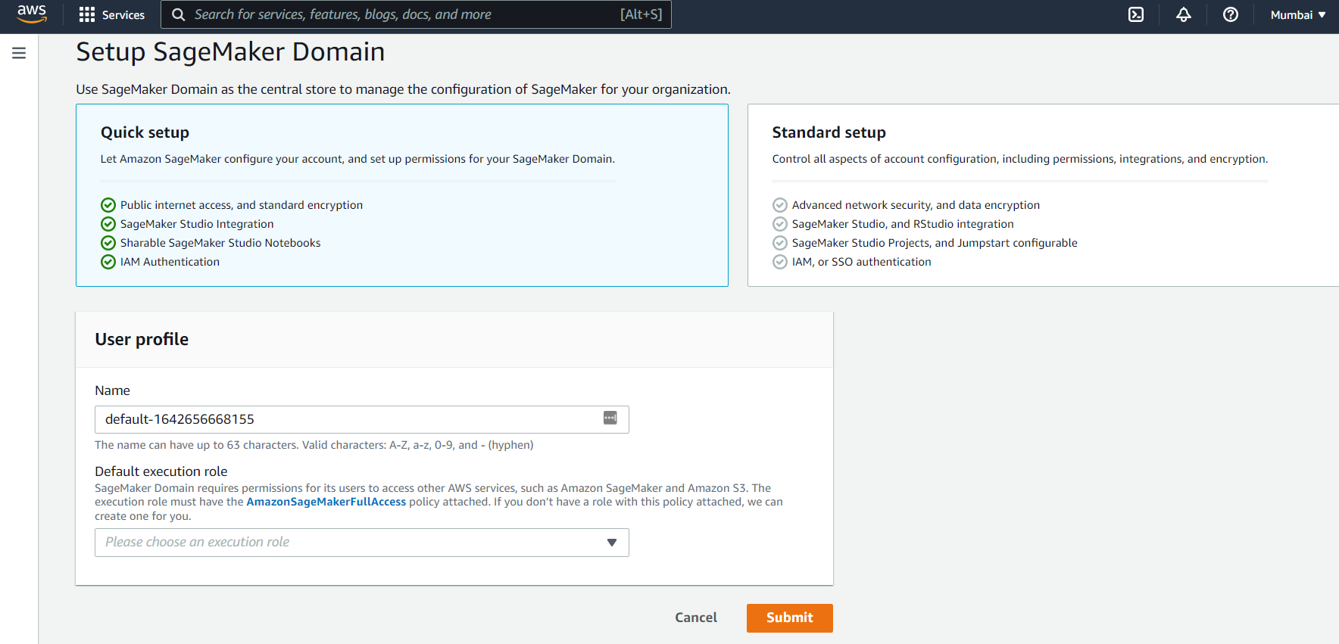
AWS SAGEMAKER DOMAIN SETUP
KEEP THE DEFAULT NAME, AND THEN CLICK ON CREATE A NEW IAM ROLE

Slide 26
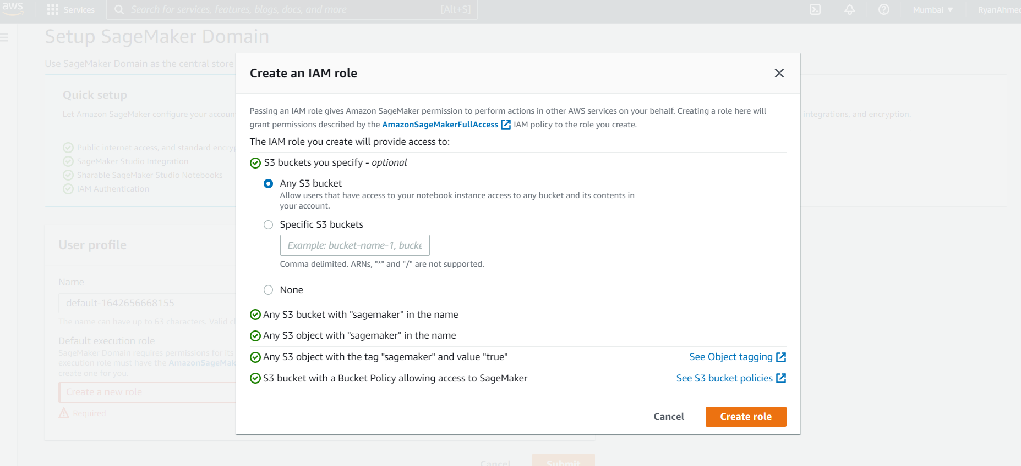
AWS SAGEMAKER DOMAIN SETUP
CHOOSE ANY BUCKET AND CLICK ON CREATE ROLE

Slide 27
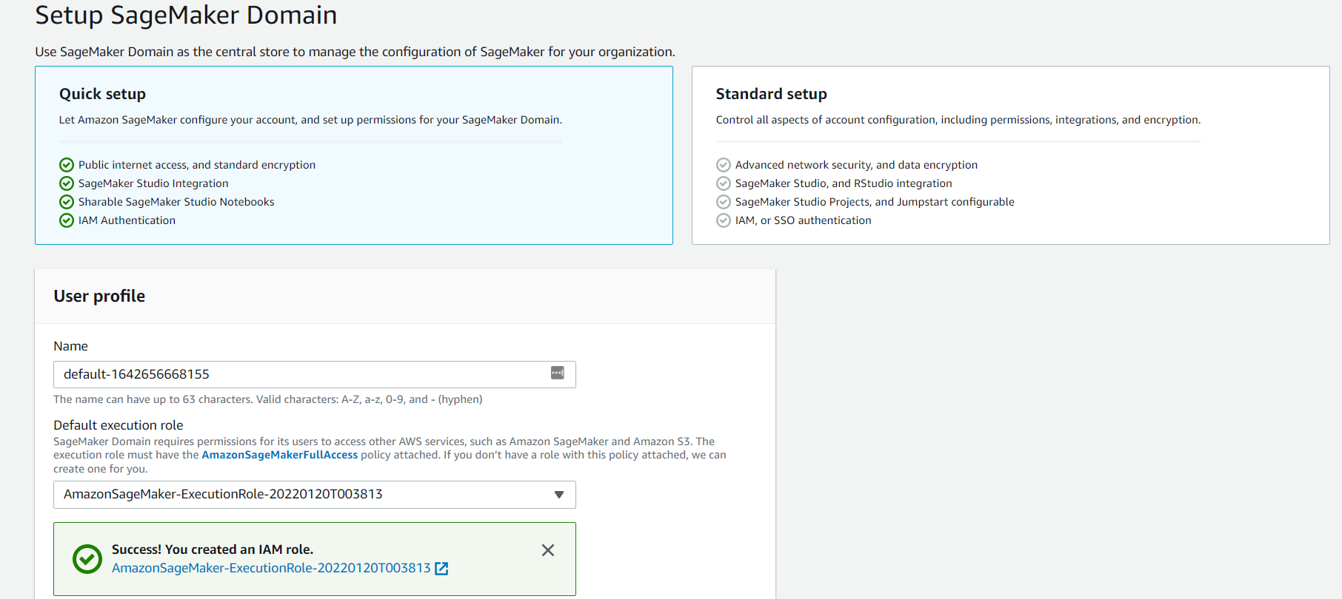
AWS SAGEMAKER DOMAIN SETUP
IAM ROLE SETUP IS NOW COMPLETE! NOW CLICK ON SUBMIT TO COMPLETE THE SAGEMAKER DOMAIN SETUP

Slide 28
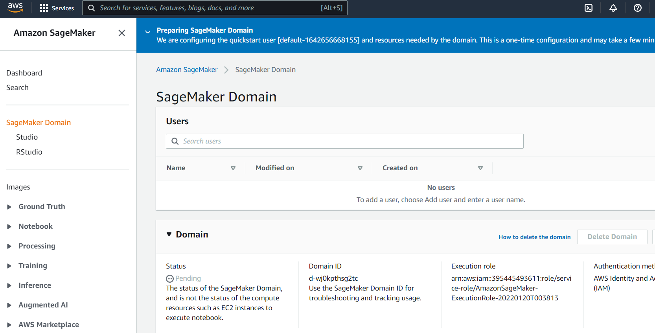
AWS SAGEMAKER DOMAIN SETUP
SAGEMAKER DOMAIN SETUP WILL TAKE COUPLE OF MINUTES

Slide 29
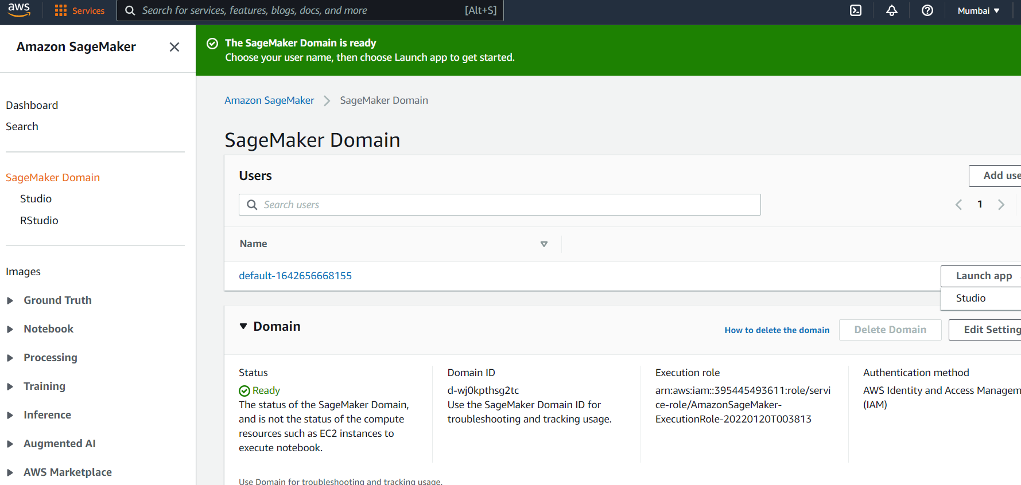
AWS SAGEMAKER DOMAIN SETUP
CONGRATUATIONS! SAGEMAKER DOMAIN SETUP IS NOW COMPLETE. CLICK ON LAUNCH APP (STUDIO)

Slide 30

AWS SAGEMAKER DOMAIN SETUP
SAGEMAKER STUDIO IS NOW LAUNCHING

Slide 31
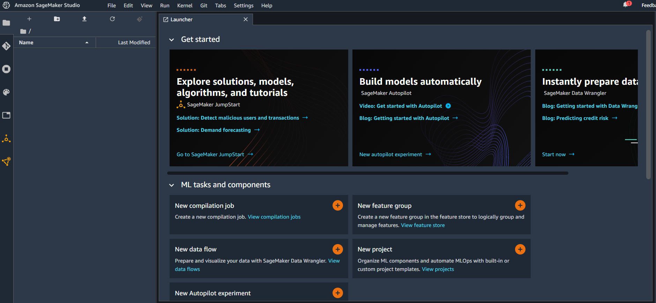
AWS SAGEMAKER DOMAIN SETUP
SAGEMAKER STUDIO HOMEPAGE

Slide 32
CODE DEMO: MULTIPLE LINEAR REGRESSION IN SKLEARN
EASY
ADVANCED

Slide 33
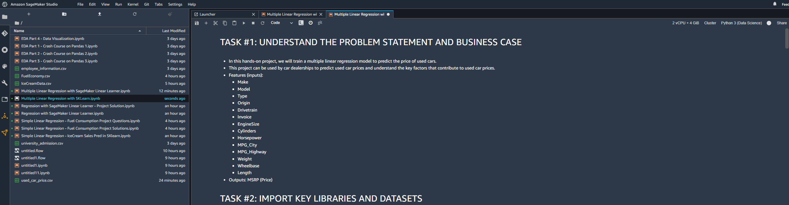
CODE DEMO

Slide 34
END-OF-DAY CAPSTONE PROJECT
EASY
ADVANCED

Slide 35
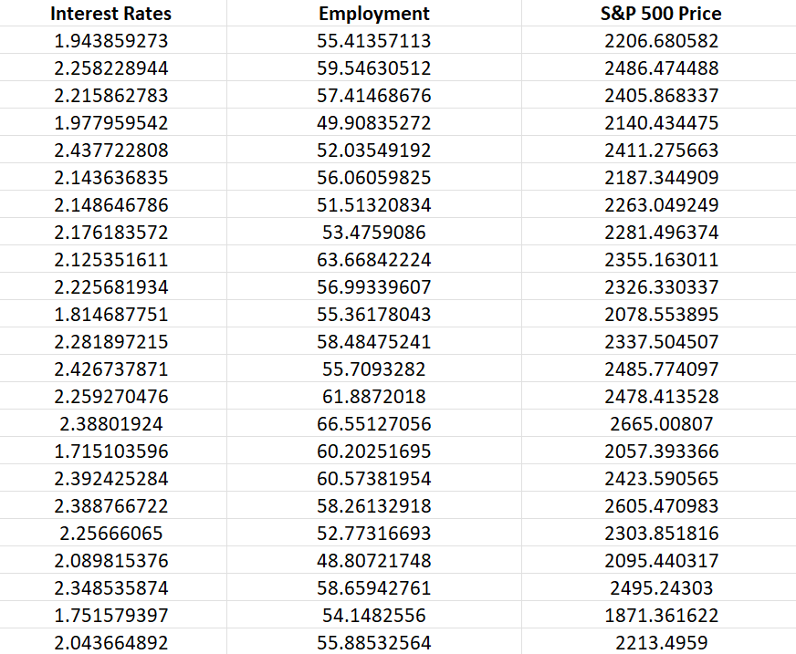
PROJECT
We would like to predict the S&P500 Price using interest rate and employment.
Independent variable X: Interest Rate and Employment
Dependent variable Y: S&P 500 Price

Slide 36
PROJECT
Using the skeleton jupyter notebook “Multiple Linear Regression with SKLearn - Project Skeleton”, perform the following:
1. Load the “S&P500_Stock_Data.csv” dataset
2. Perform data visualization and basic exploratory data analysis
3. Split the data into 80% for training and 20% for testing
4. Train a machine linear regression model in Scikit-Learn
5. Assess trained model performance
6. Visualize the results in 3D

